Slide 2
Welcome
Aging in Supportive Housing Guide Webinar February 11, 2025

Slide 3
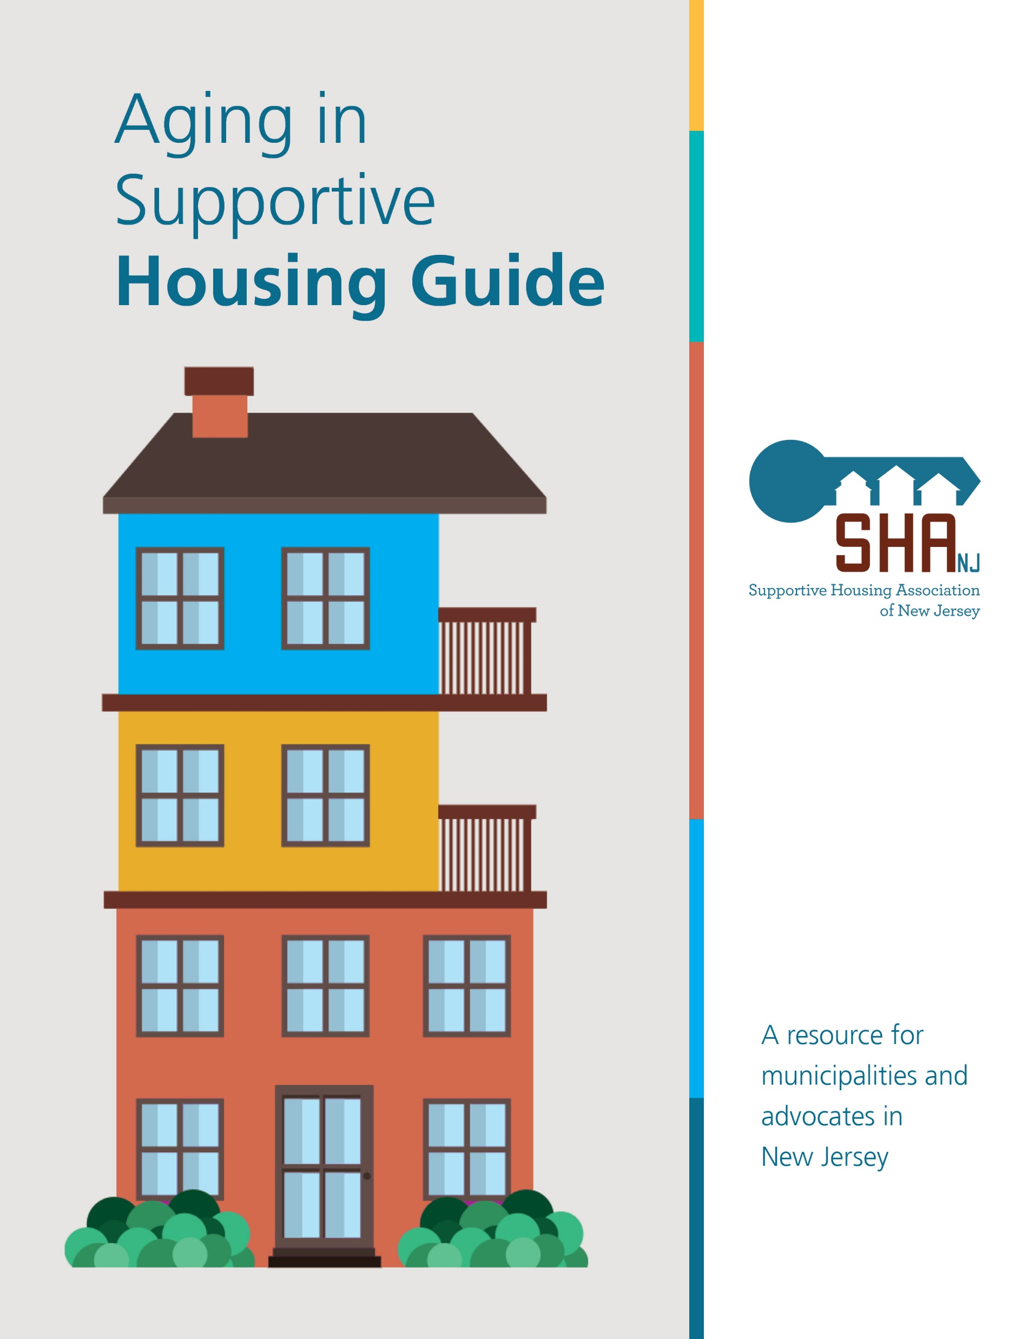
Kate Kelly
Executive Director
Supportive Housing Association of New Jersey
Aging in Supportive Housing Guide

Slide 4
Aging in Supportive Housing Guide
Acknowledgements
The Aging in Supportive Housing Guide was funded by a grant from The Henry and Mary Taub Foundation. We thank the Foundation and our member and partner organizations for their support in making this Guide possible.

Slide 5
Supportive Housing Association of New Jersey (SHA)
The Supportive Housing Association of New Jersey (SHA) is a statewide, nonprofit organization, founded in 1998, whose mission is to promote and maintain a strong supportive housing industry in New Jersey serving people with special needs.
Supportive Housing is a philosophy and model that advocates the development of safe, permanent, affordable homes with supportive services in communities for people who live with special needs

Slide 6
Aging in Supportive Housing Guide
The Supportive Housing Need in NJ
The population of people in NJ aged 65 and older will grow from 17% (2024) to 22% (2040) of population. (Administration for Community Living, May 2024)
As population grows, more people who are aging will face challenges and barriers
Today, 30% of the almost 967,000 people in NJ with disabilities are over the age of 65. (Rutgers University, June 2024)
NJ needs strategic planning to allow citizens who are aging housing options in the towns of their choice that are available, accessible, or affordable.

Slide 7
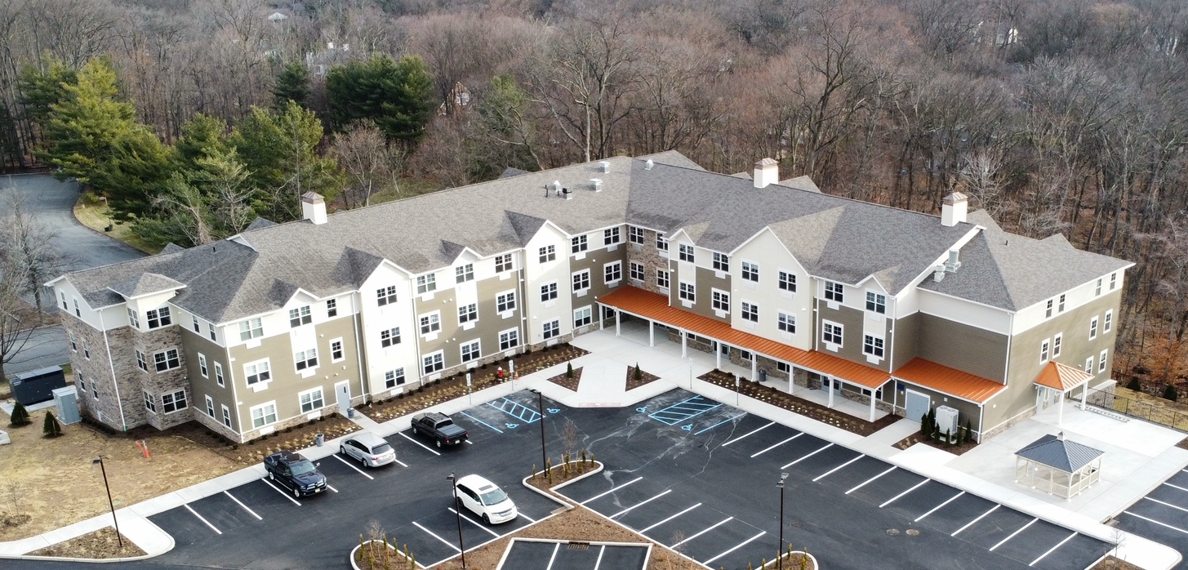
Aging in Supportive Housing Guide
Why the Guide?
Individuals who are aging would like more varied housing options and communities
Supportive housing provides opportunities for cities and towns to fulfill affordable housing obligations and strengthen their communities
The Residences at Upper Saddle River

Slide 8
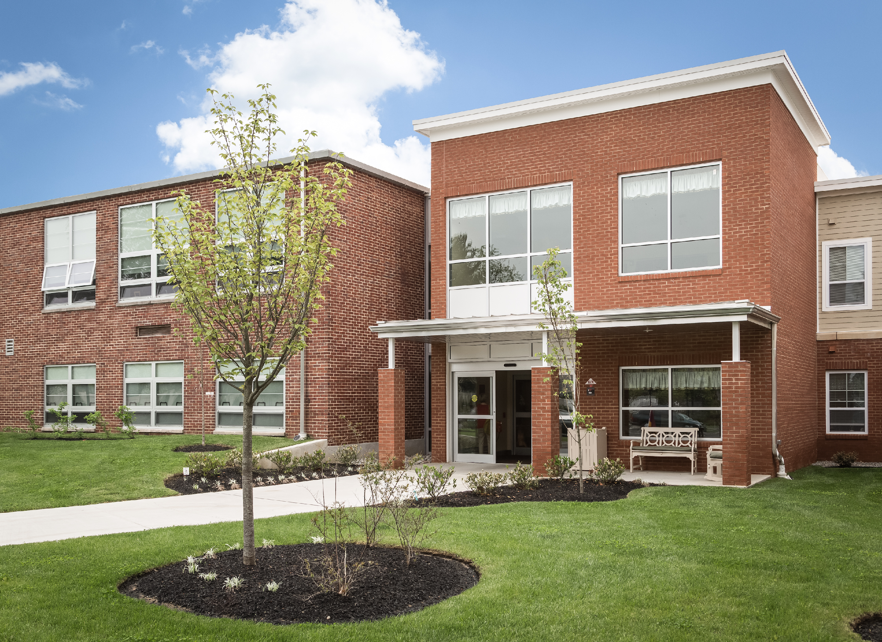
Aging in Supportive Housing Guide
An Opportunity
New landmark affordable housing legislation allows us to look ahead for next 10 years
Municipalities can envision variety of supportive housing to include in their housing plans
They can also develop new supportive housing to meet needs of mixed populations
Developers can include a mix of tenants aged 55 and over with other populations – individuals with disabilities or mental illness, veterans, individuals who have experienced homelessness
Springside School Apartments

Slide 9
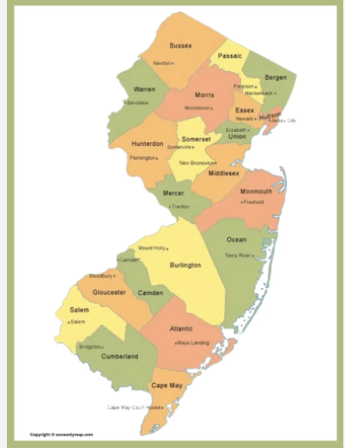
Aging in Supportive Housing Guide
The Audience
Municipal elected officials and staff
Organizations interested in developing supportive housing
Developers and consultants
Advocates

Slide 10
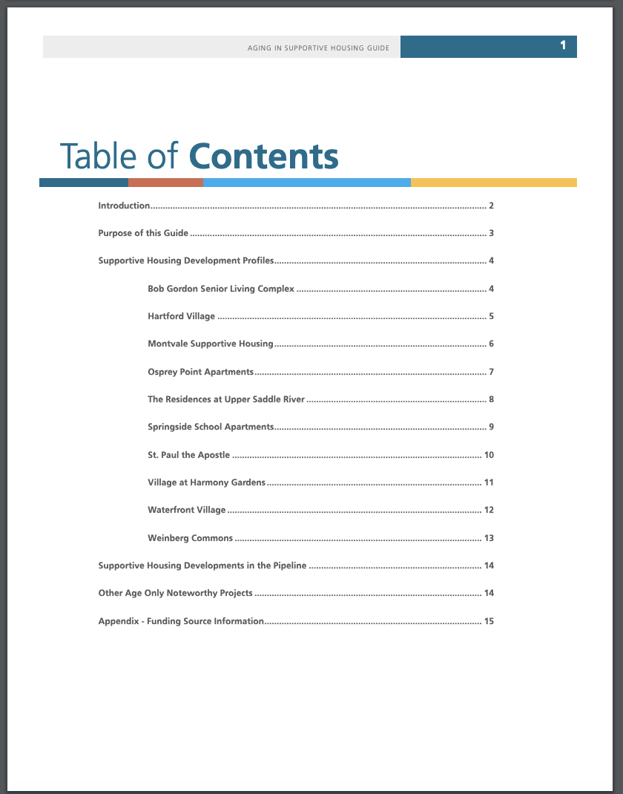
Aging in Supportive Housing Guide
What Is Included
Ten successful supportive housing project profiles
Supportive housing projects in the pipeline
Other age-only noteworthy projects
Appendix of funding sources

Slide 11
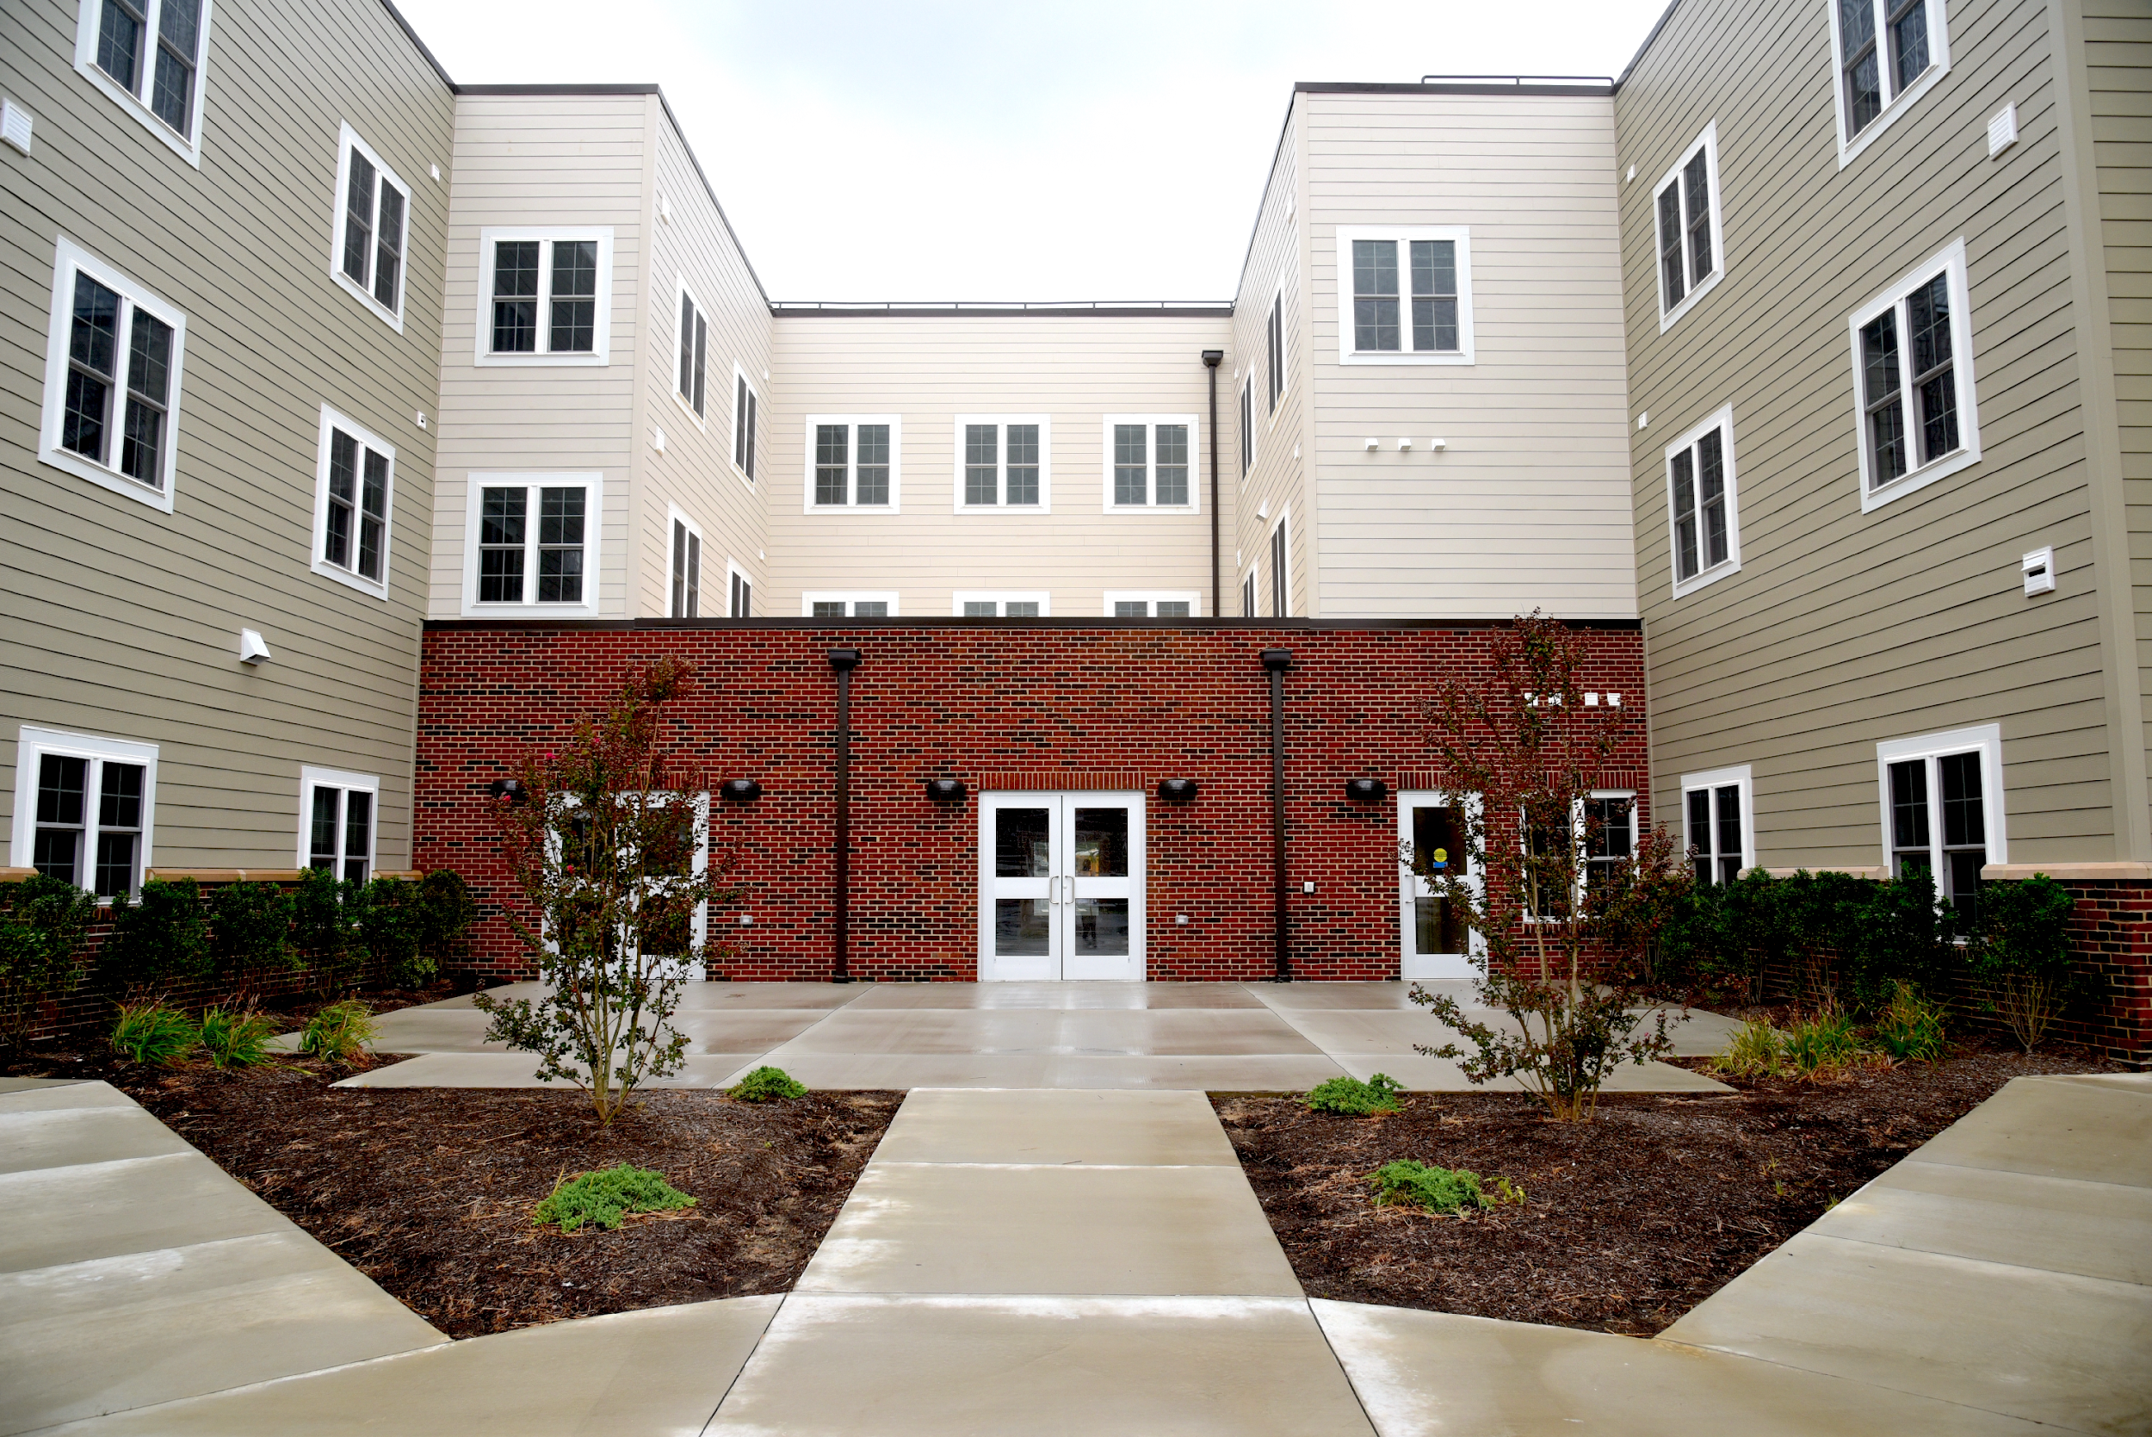
Aging in Supportive Housing Guide
How Projects Selected
Development teams include SHA members and partners
Vary in size
Different funding sources
Located in municipalities of different sizes across NJ
Homes for populations with different service needs
St. Paul the Apostle

Slide 12
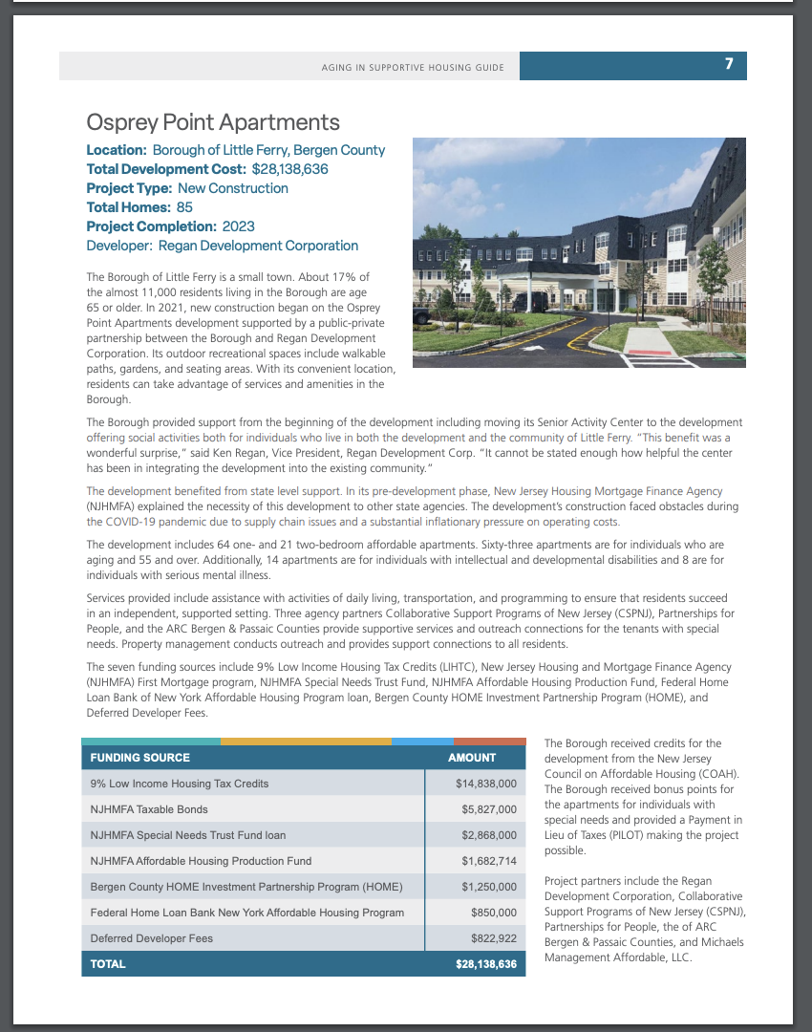
Aging in Supportive Housing Guide
Project Profiles
Basic information: Location, cost, project type, total homes, completion date, developer
History, description, and benefit to municipality
Development tips
Services provided to residents
Capital stack of funding sources
Members of project team

Slide 13
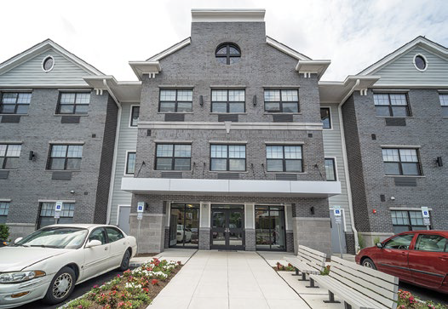
Bob Gordon Senior Living Project
Location: Borough of Fair Lawn, Bergen County
Total Development Cost: $21,581,086
Project Type: New Construction
Total Homes: 85
Project Completion: 2020
Developer: Bergen County’s United Way/Madeline Housing Partners LLC. and Penwal Affordable Housing

Slide 14
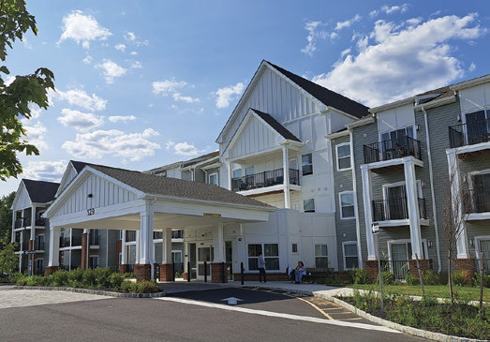
Hartford Village
Location: Medford Township, Burlington County
Total Development Cost: $15,039,286
Project Type: New Construction
Total Homes: 71
Project Completion: 2022
Developer: Volunteers of America Delaware Valley
(VOADV) Property

Slide 15
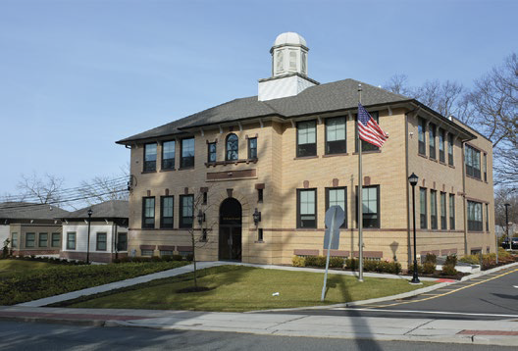
Montvale Supportive Housing
Location: Borough of Montvale, Bergen County
Project Type: Renovation
Total Homes: 14
* 10 affordable one-bedroom apartments and a 4-bedroom group home. Apartments are for individuals who are aging, and the group home for individuals with intellectual and developmental disabilities.
Project Completion: 2018
Developer: Bergen County’s United Way/Madeline
Housing Partners LLC.

Slide 16
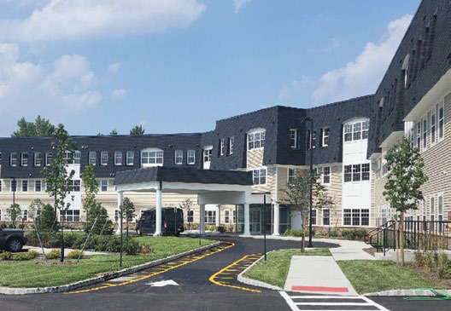
Osprey Point Apartments
Location: Borough of Little Ferry, Bergen County
Total Development Cost: $28,138,636
Project Type: New Construction
Total Homes: 85
Project Completion: 2023
Developer: Regan Development Corporation

Slide 17
The Residences at Upper Saddle River
Location: Borough of Upper Saddle River,
Bergen County
Total Development Cost: $25,636,511
Project Type: New Construction
Total Homes: 70
Project Completion: 2023
Developer: Housing Development Corporation of
Bergen County; Development Consultant: Monarch Housing Associates

Slide 18
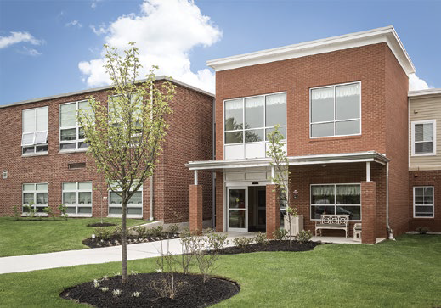
Springside School Apartments
Location: Burlington Township, Burlington County
Total Development Cost: $18,204,554
Project Type: Renovation
Total Homes: 75
Project Completion: 2014
Developer: Conifer; Architect: Thriven Design

Slide 19
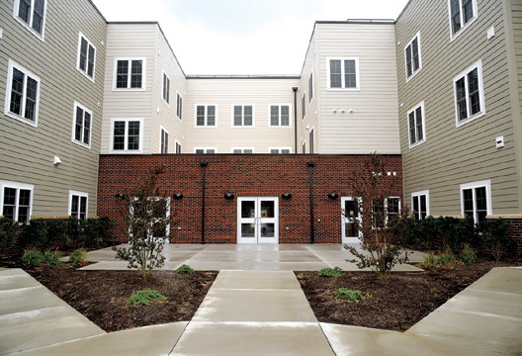
St. Paul the Apostle
Location: Township of Edison, Middlesex County
Total Development Cost: $11,280,490
Project Type: New Construction
Total Homes: 42
Project Completion: 2021
Developer: Domus Corporation and
Metuchen Community Services Corporation; Development Consultant: Monarch Housing Associates

Slide 20
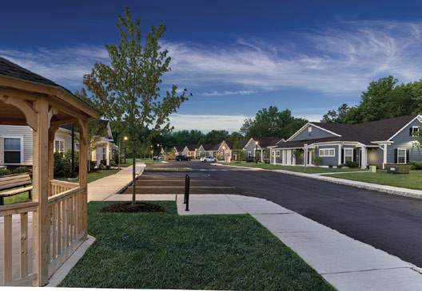
Village at Harmony Gardens
Location: Borough of Glassboro, Gloucester County
Total Development Cost: $21,425,317
Project Type: Redevelopment
Total Homes: 65
Project Completion: 2023
Developer: Pennrose, LLC

Slide 21
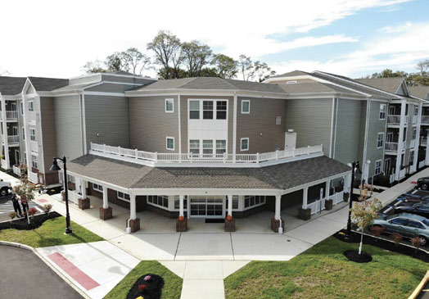
Waterfront Village
Location: Bordentown Township, Burlington County
Total Development Cost: $21,024,615
Project Type: New Construction
Total Homes: 70
Project Completion: 2019
Developer: Volunteers of America Delaware
Valley (VOADV) Property

Slide 22
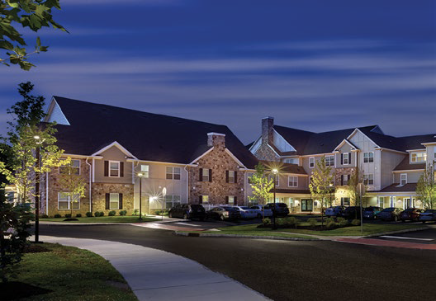
Weinberg Commons
Location: Cherry Hill Township, Camden County
Total Development Cost: $39,663,265
Project Type: New Construction
Total Homes: 160
Project Completion: 2019
Developer: Pennrose, LLC
Notes:
Mention role Thriven played in project!

Slide 23
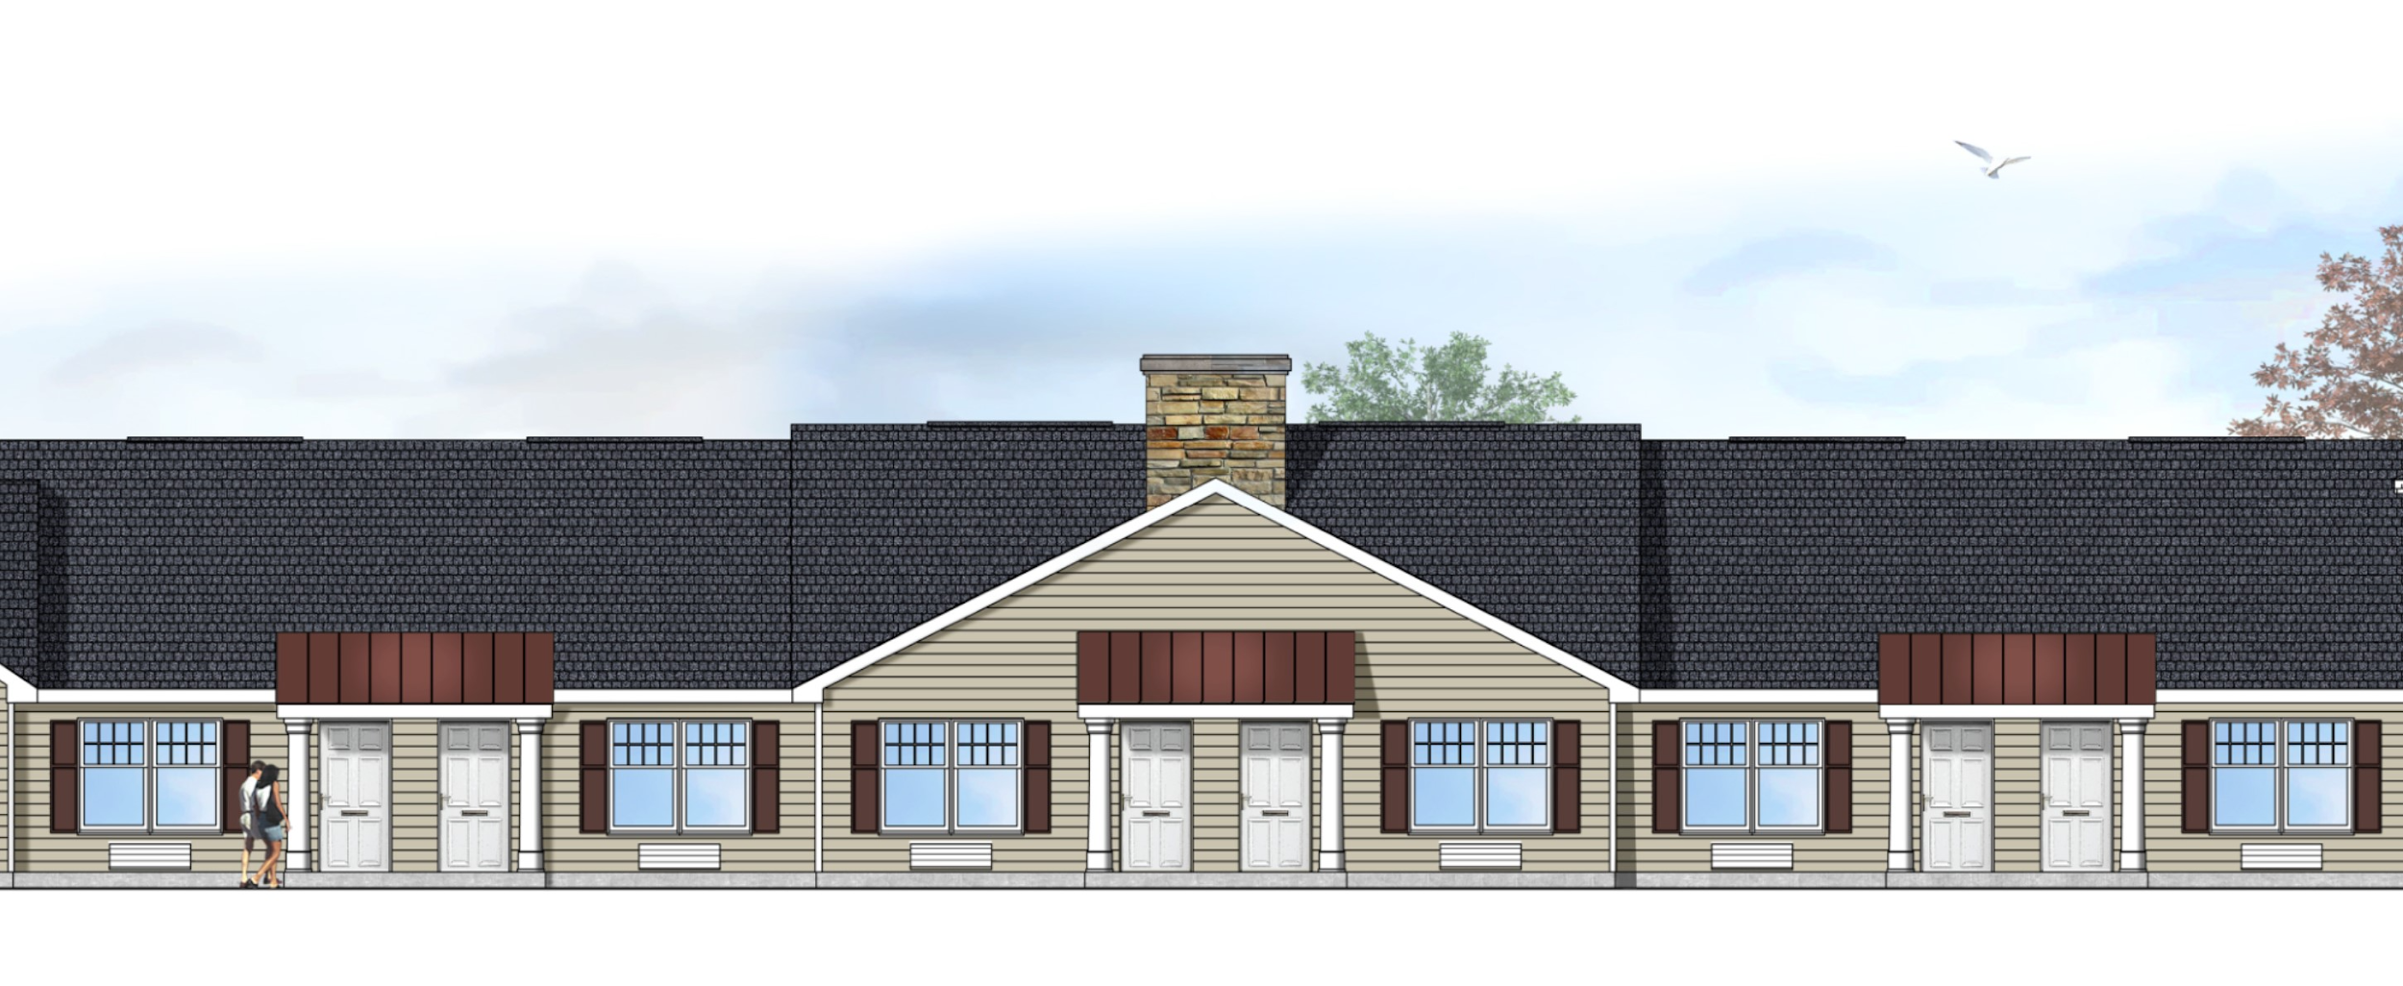
Supportive Housing Projects in the Pipeline
Avenel Veterans – Woodbridge; Pennrose
Allen House II – Millstone; Affordable Housing Alliance
Bayonne Supportive Housing; Bergen County’s United Way/Madeline Corporation
Oliver Station – Camden; The Michael’s Organization
The Roosevelt – Mount Laurel; Fair Share Housing Development
Allen House II

Slide 24
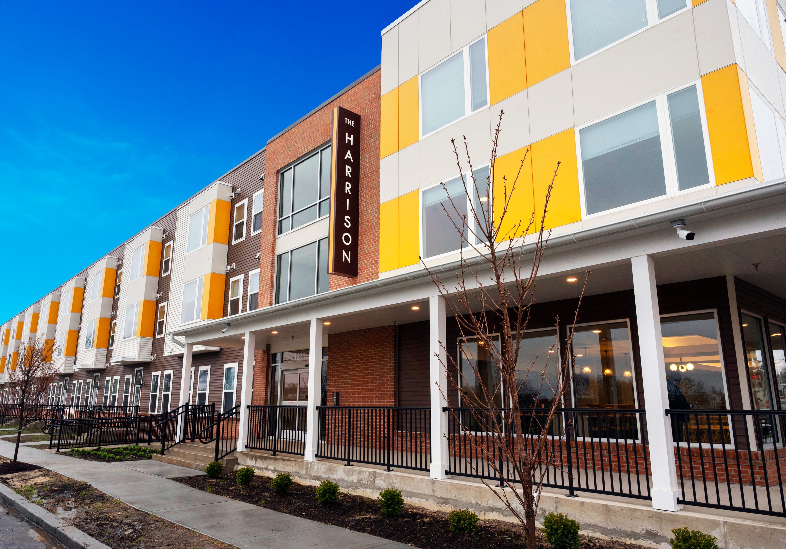
Other Age – Only Noteworthy Projects
Lord Stirling Apartments - New Brunswick; The Community Builders
The Village at Garwood – Monarch Housing Associates (Development Consultant)
The Harrison – Camden; The Michael’s Organization
The Harrison

Slide 25
Aging in Supportive Housing Guide
Appendix
All funding sources with definitions used to finance developments featured in Guide

Slide 26
Aging in Supportive Housing Guide
Promoting and Sharing the Guide
On SHA’s website and printed copies
Presentations or round tables segmenting guide content through different lenses
- What content might you want to see segmented?
Conferences in NJ with interested audiences
Other ideas?

Slide 27
Aging in Supportive Housing Guide
Related Resources
SHA - Housing Hub and Integrated Community Project (ICP)
Other - HUD Resource Locator and Disability Snapshots (Rutgers)

Slide 28
Aging in Supportive Housing Guide
What other resources focused on different populations and/or topics would be of value to you in your work?
Questions?
Email - Kate Kelly, kate.kelly@shanj.org

